Slide 1
Lists

Slide 2
Lists :
A list can be defined as a collection of values or items of different types. The items in the list are separated with the comma (,) and enclosed with the square brackets [ ].
Lists are just like the arrays, declared in other languages. Lists need not be homogeneous always which makes it a most powerful tool in Python.
A single list may contain Datatypes like Integers, Strings, as well as Objects.
In Python, list is a type of container in Data Structures, which is used to store multiple data at the same time.

Slide 3
Creating Lists :
Lists in Python can be created by just placing the sequence inside the square brackets[ ].
List = [ ] → creating blank list
List =[ ‘Apple’] →list with string
List = [‘ Apple’ , ’ Orange ’, ’mango’] → list with multiple values
List = [1,2,3,4,5,6] → list with multiple integer values
List = [1,2, ‘apple’, ‘mango’, 6, 7, ‘mango’] →list with multiple data types

Slide 4
List indexing and splitting :
The indexing are processed in the same way as it happens with the strings. The elements of the list can be accessed by using the slice operator [ ].
The index starts from 0 and goes to length - 1.
The first element of the list is stored at the 0th index, the second element of the list is stored at the 1st index, and so on.

Slide 5
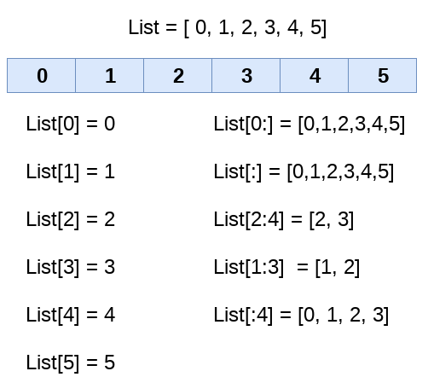
Consider the following example :

Slide 6
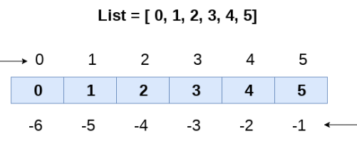
Unlike other languages, python provides us the flexibility to use the negative indexing also.
The negative indices are counted from the right.
The last element (right most) of the list has the index -1, its adjacent left element is present at the index -2 and so on until the left most element is encountered.

Slide 7
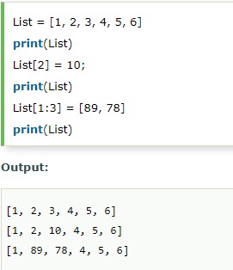
Updating list values :
Lists are the most versatile data structures in python since they are mutable and their values can be updated by using the slice and assignment operator.
Python also provide us the append() method which can be used to add values to the string.

Slide 8
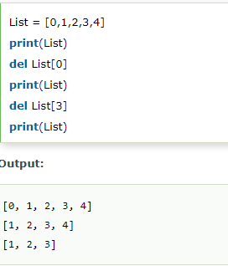
The list elements can also be deleted by using the del keyword.
Python also provides us the remove() method if we do not know which element is to be deleted from the list.

Slide 9
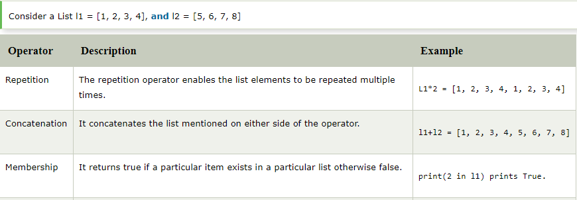
Python list operations :
The concatenation (+) and repetition (*) operator work in the same way as they were working with the strings.
Lets see how the list responds to various operators.

Slide 10
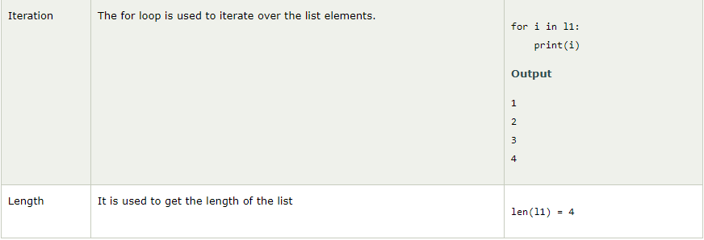

Slide 11
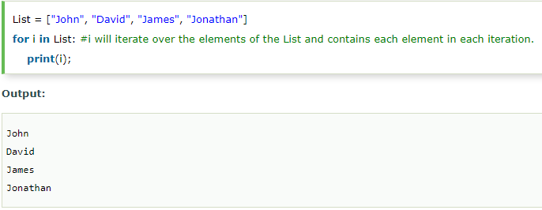
Iterating a List :
A list can be iterated by using a for - in loop. A simple list containing four strings can be iterated as follows.

Slide 12
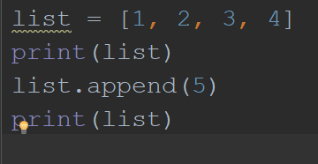
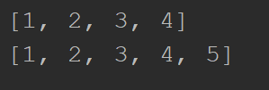
Adding element to the list :
Python provides append() function by using which we can add an element to the list. However, the append() method can only add the value to the end of the list.
output

Slide 13
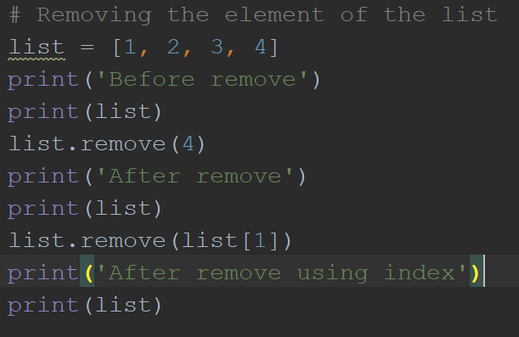
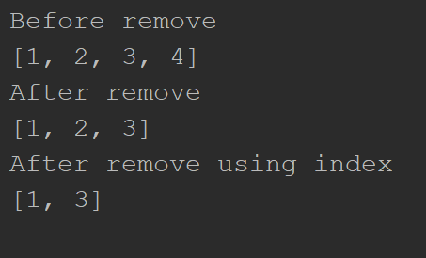
Removing elements from the lists :
Output

Slide 14
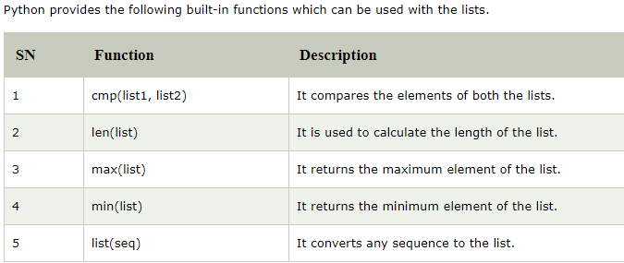
Python Lists Built-in functions:

Slide 15
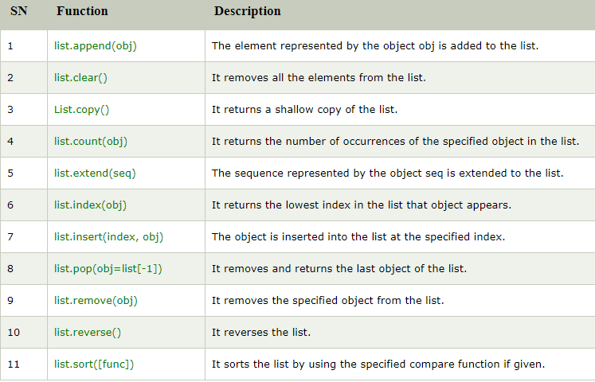
Python Lists built-in methods:

Slide 16
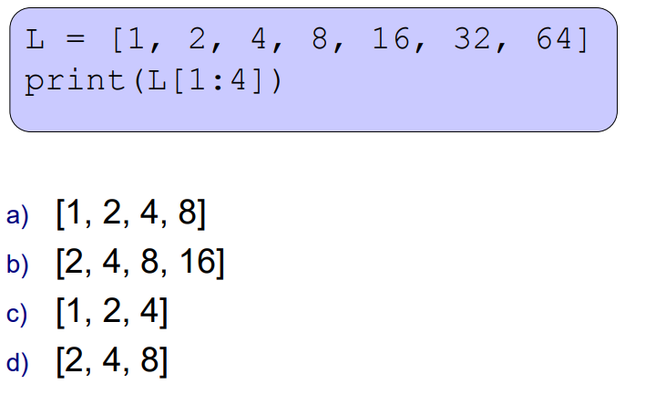
Quiz:

